Slide 1
Bibliographic field Title (complete) with additional subfields
Yoel Kortick. Senior Librarian

Slide 2


Introduction
Example

Slide 3
Introduction

Slide 4
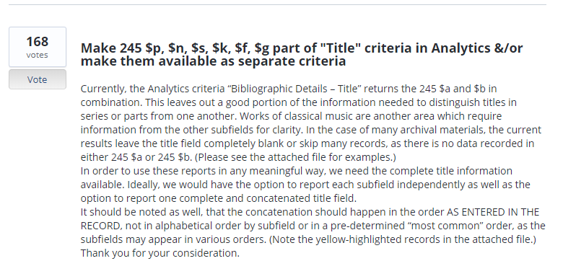
Introduction
This development originated from this Ideas Exchange request

Slide 5
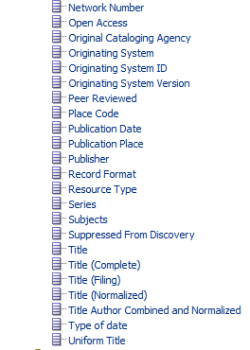
Introduction
As of Nov. 2019 a new bibliographic field “Title (complete)” has been added to the shared folder “Bibliographic Details”.
This field contains additional subfields than those in the existing “Title” field of Alma Analytics.
Among the additional subfields are h, c, p, n, s, k, f, g.

Slide 6
Examples

Slide 7
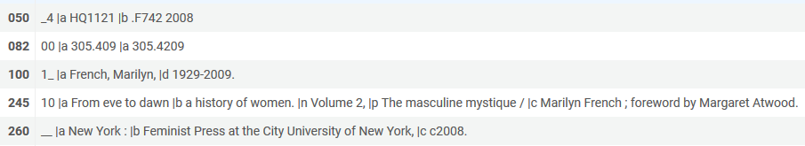
Example 1
Here is MMSIDS 99216589500121 title “From Eve to Dawn” which has a 245 field as follows.
It includes subfields a, b, c, n, p.

Slide 8
Example 1
Here it is in Alma Analytics and Alma:
Subfields a, b
Subfields a, b, n, p, c.

Slide 9
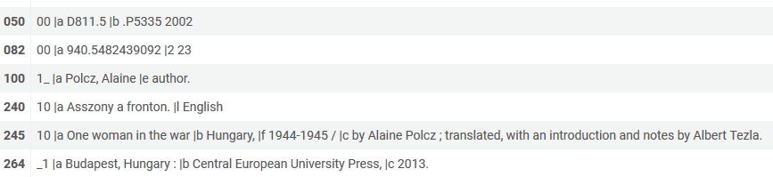
Example 2
Here is MMSIDS 99216589600121 title “One woman in the war” which has a 245 field as follows.
It includes subfields a, b, c, f, h.

Slide 10
Example 2
Here it is in Alma Analytics and Alma:
Subfields a, b
Subfields a, b, f, c.

Slide 11
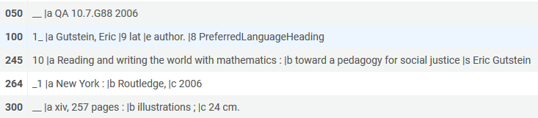
Example 3
Here is MMSIDS 99216589400121 title “Reading and writing the world with mathematics” which has a 245 field as follows.
It includes subfields a, b, s.

Slide 12
Example 3
Here it is in Alma Analytics and Alma:
Subfields a, b
Subfields a, b, s.

Slide 13
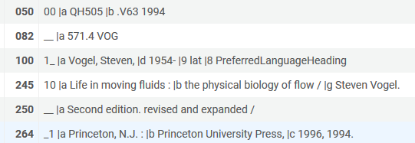
Example 4
Here is MMSIDS 99216589300121 title “Life in moving fluids” which has a 245 field as follows.
It includes subfields a, b, g.

Slide 14
Example 4
Here it is in Alma Analytics and Alma:
Subfields a, b
Subfields a, b, g.

Slide 15
Yoel.Kortick@exlibrisgroup.com

